Slide 1


Slide 2
“Libre Not Gratis, free as in freedom of speech, a freedom to use, understand, modify and share the software.”
--Richard Stallman

Slide 3

How It Came into the Picture?
GNU Linux Users Group, or better known as GLUG, happened when a group of students were actively supporting free software. The sole purpose and inception of the club, right from the very beginning, is kept quite simple- Open to any free software enthusiasts.

Slide 4
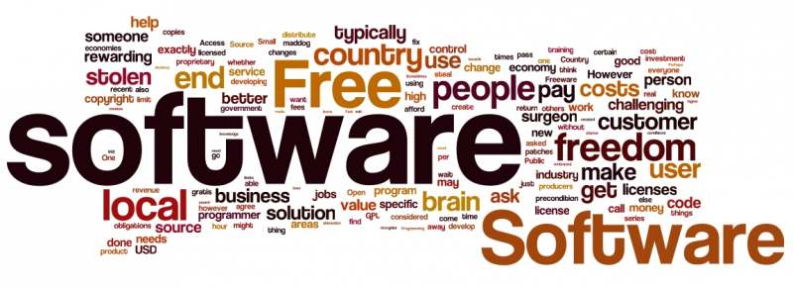

Slide 5
1. More eyeballs is all you need... A commercial software is developed, tested and debugged by a handful of employees, on the other hand, an open source software can be improved upon by big community of people. Resulting in a much better and highly optimized software. 2. Learn from others You can view and run the code of other contributors, learn from their mistakes and at the same time work towards excellence collectively 3. Do what you are best at You can contribute to the software you want to, can do the work you like to do and you are best at. In this way the resulting software​ you get is also the best.

Slide 6
1. BE ADVENTUROUS, EXPLORE!!
GLUG provides you a platform to explore yourselves and find your hidden talent within various areas of interests ranging from cyber security, web development, app development and many other technical fields.
2. LEARN, SHARE AND EVOLVE!
It is an interactive community where you can freely express your ideas and share them with other members who can help you in working towards a better approach and implement it later on!
3. BECOME DYNAMIC FROM STATIC!
We help you improve your skillset and be updated with technical advancements through various sessions with industrial experts and workshops involving hands on learning.

Slide 7
1. Participation in National GLUG Conference Web Development
2. Machine Learning Workshop
3. Industrial Interaction with Experts
4. Hands on Session of Coding
5. Big Data
6. Hackathons
8. Android Development
9. Web Development
AND MANY MORE TO COME!

Slide 8
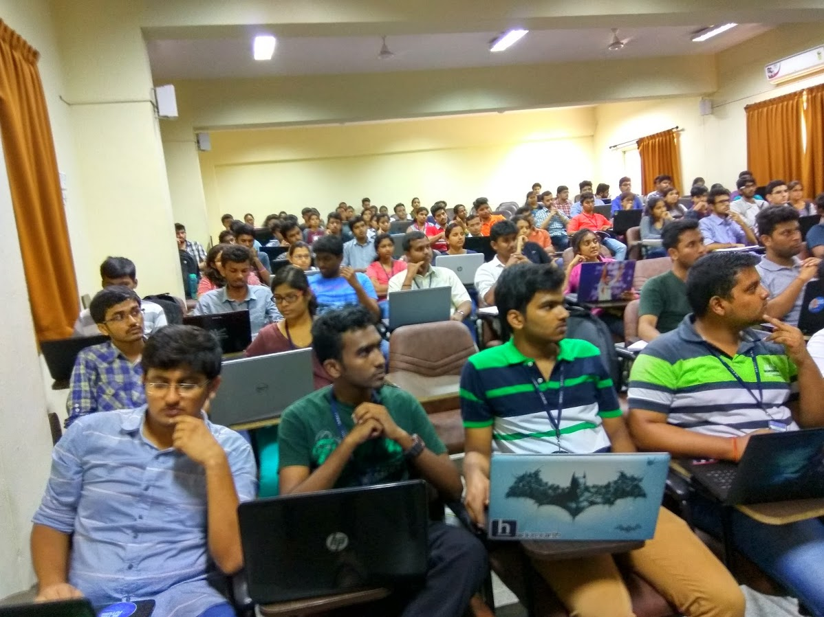
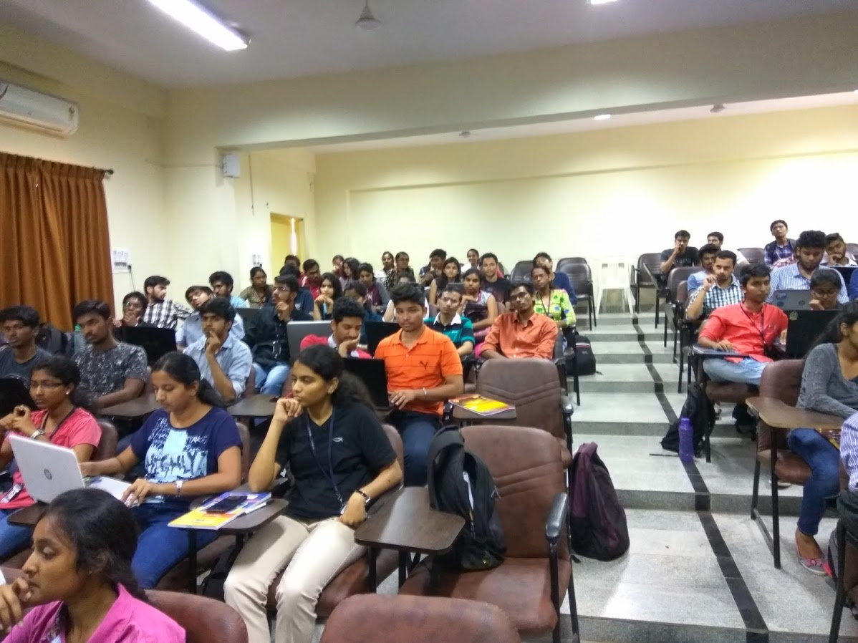
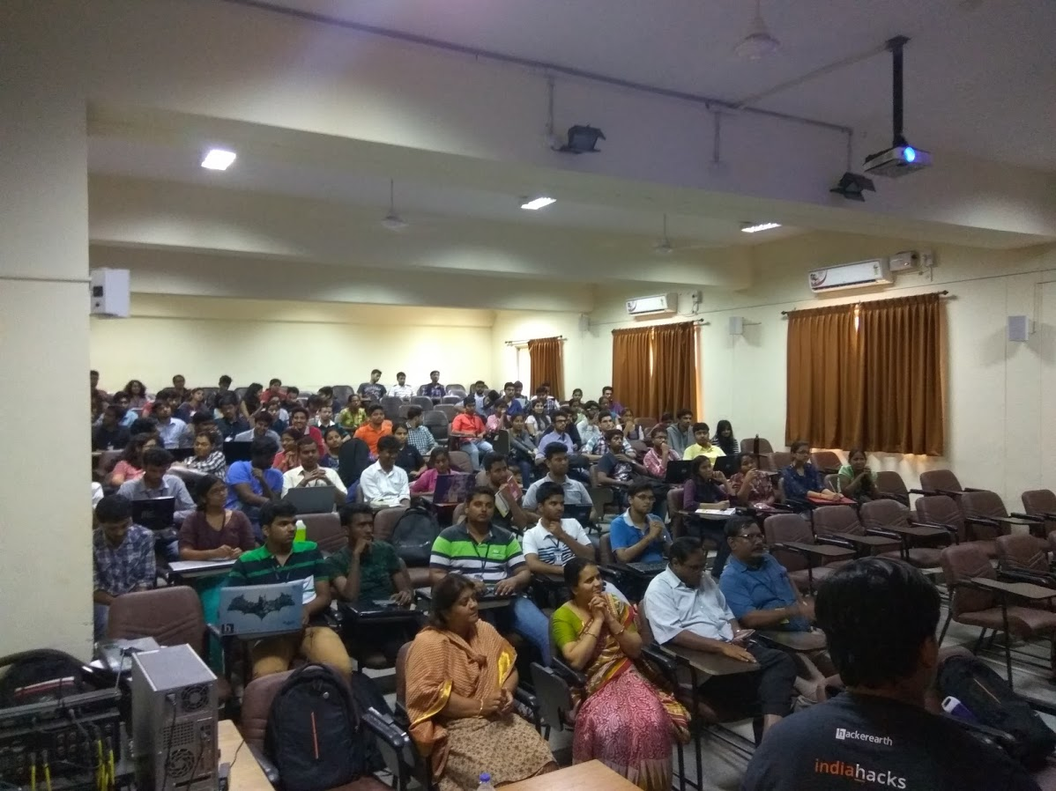

Slide 9
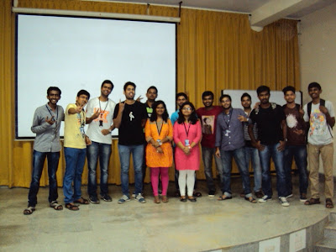
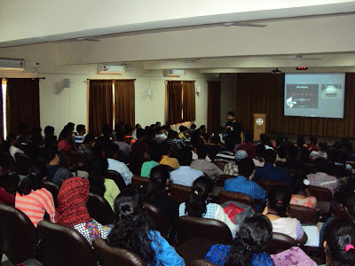

Slide 10
“People always fear change. People feared electricity when it was invented, didn’t they? People feared coal, they feared gas-powered engines. There will always be ignorance, and ignorance leads to fear. But with time, people will come to accept their silicon masters.”
---BILL GATES

Slide 11
Sreejeeth: 7204374397
Vipul: 9986804620
Abhijeet: 9741118993
Susmit: 9739594250
Contact any of us for any queries and details!

